Slide 1
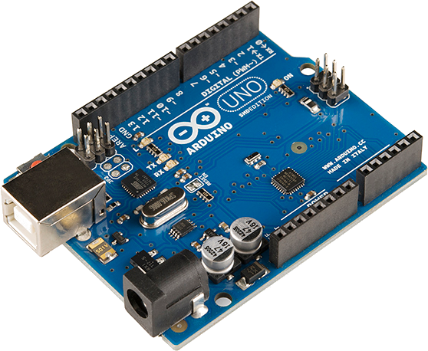

Welcome to Engineering Summer Program for Teachers 2025
ELECTRICAL ENGINEERING AND COMPUTER SCIENCE, COLLEGE OF ENGINEERING AND PHYSCIAL SCIENCES

Slide 2
Getting Started
Go to desktop folder: Workshop Materials\Arduino\Day 1 - Arduino
Open this presentation: ElectronicsIntro.pptx or ElectronicsIntro.pdf
What to do
Follow along. Go forward or backward at your own pace
During Hands-On sessions you can
Zoom in or Zoom out on detailed diagrams
Go back to previous slides
Work ahead if you want to

Slide 3
Basic Electronics
Let’s get started!
ELECTRICAL ENGINEERING AND COMPUTER SCIENCE, COLLEGE OF ENGINEERING AND PHYSCIAL SCIENCES

Slide 4
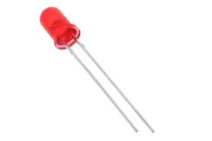
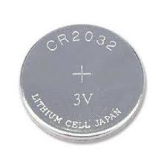
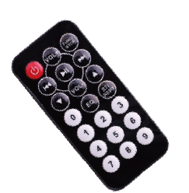
Find LED and Battery
LED
Any color of LED is ok
Extract from Remote Control
3V Battery

Slide 5
Making LEDs work
Our First Circuit
Find the button battery
Find an LED
Touch battery to the LED legs – does LED light up?
Can we find a rule to make the LED light?
LED
3V Battery
Place long leg on (+) side
Short leg on the (-) side
Notes:
Connect long leg to + (anode)
Connect flat side to – (cathode)

Slide 6
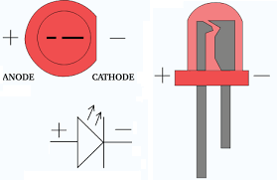
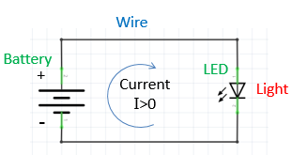
How to Connect LED
LONG leg to PLUS
SHORT leg to NEG
Long Leg
Short Leg
Circuit Diagram
Notes:
Connect long leg to + (anode)
Connect flat side to – (cathode)

Slide 7
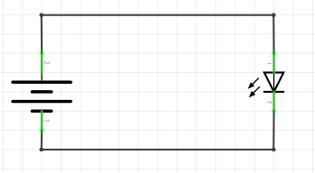
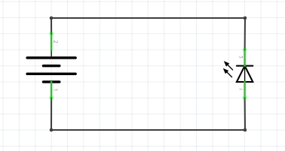

Current Flow
Electricity flow is called “current”
It flows from plus+ to minus-
A “Diode” only lets current flow one way
LED is “Light Emitting Diode”
Lights up only when current is flowing
Current
Blocked!
Wire
Wire
Battery
Battery
+
LED
+
LED
Current
I>0
No current
I=0
-
-
Emits LIGHT
Emits DARK
Notes:
Connect long leg to + (anode)
Connect flat side to – (cathode)

Slide 8
Interesting Details
Electrical engineers refer to current as “I”
Current “Intensity”
A battery is called a “voltage source”
Produces constant voltage, but current can vary
Batteries have plus(+) and minus(-) sides
Alternative notation: plus(+) and Ground (GND)
Think of Ground as being at zero volts
E.g., the 5-volt Arduino power supply is labeled: "+5V” and “GND”

Slide 9

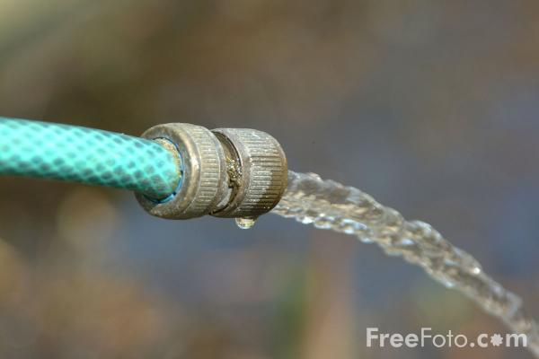
Electricity: the Water Hose Analogy
Resistance
“Ohms”
Pressure
“Volts”
Current
“Amps”
Notes:
Thumb on end of hose varies resistance. Which varies current.
Which makes a good water fight.
Voltage is a measure of available energy in each unit of charge.
It’s like how many gallons of gasoline are in your tank

Slide 10
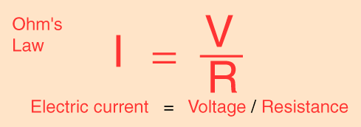
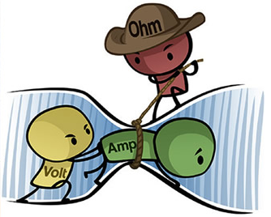
Here’s the math
Here’s what’s really happing

Slide 11

Set Up Your Resistor bags
Your kit includes many resistor values.
Find the following: 220, 1K, 10K
We’ll use these in this workshop
Good idea to put them in small plastic bags.
Label them with a Sharpie
220
Ohms
1K
Ohms
10K
Ohms
bag 1
bag 2
bag 3

Slide 12
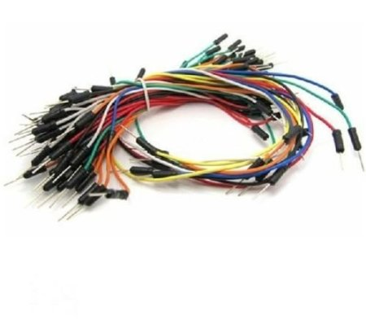
Find Your Jumpers
We use these to make electrical connections
Remove the binder from the jumpers
Notes about using jumpers:
Color doesn’t matter
Use the shortest jumper that works (for neatness)
Cut off

Slide 13
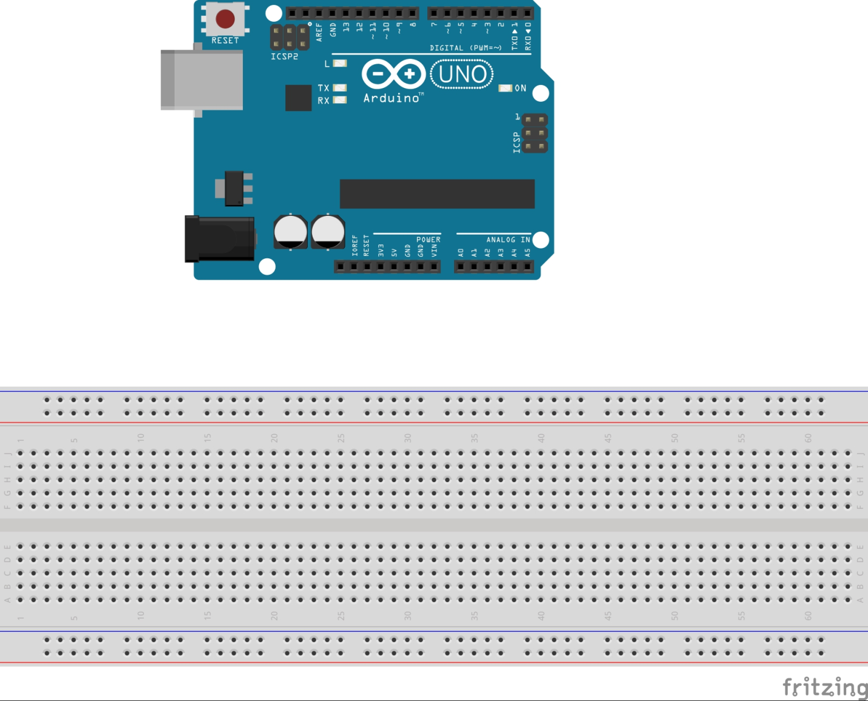
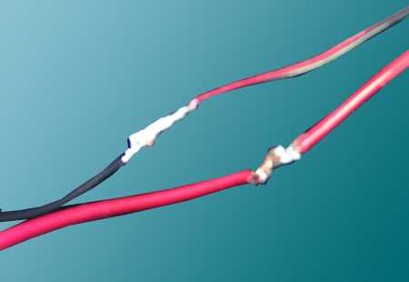
Making Connections
Solder connection
No solder needed
Breadboard
Permanent circuits are usually connected using “solder”.
For experimentation, we use “Solderless Breadboards”
Everyone please get your breadboard

Slide 14
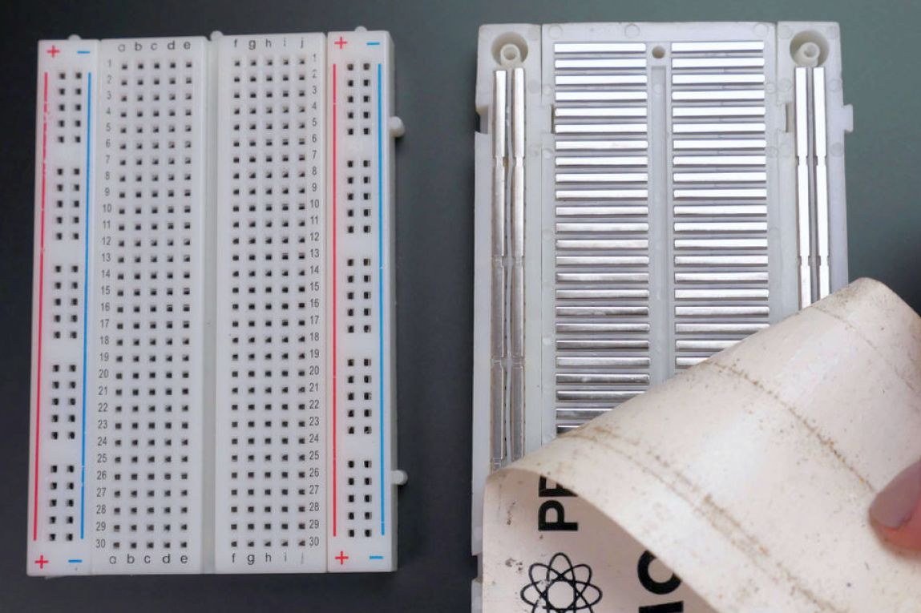
How They Work
Each group of 5 holes is connected electrically
Side “rail” holes are connected as well
Front
Back
Side Rails
Please Don’t Do This!

Slide 15
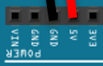
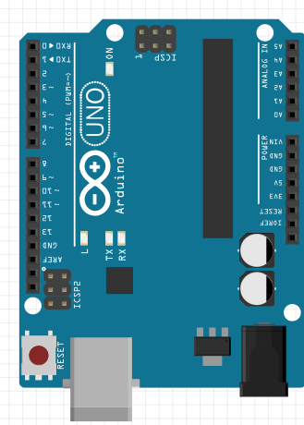
How to connect power to a breadboard
We’ll get voltage from Arduino, not from a battery
Use jumper to connect 5V to any Red hole
Use jumper to connect GND to any Blue hole
Arduino has three GND sockets – whichever is convenient.
Optional: add jumpers from top to bottom
Good idea to keep them on all week
5V
GND
GND
GND
5V
GND
Now, both top and bottom rails can be used for +5V or GND

Slide 16
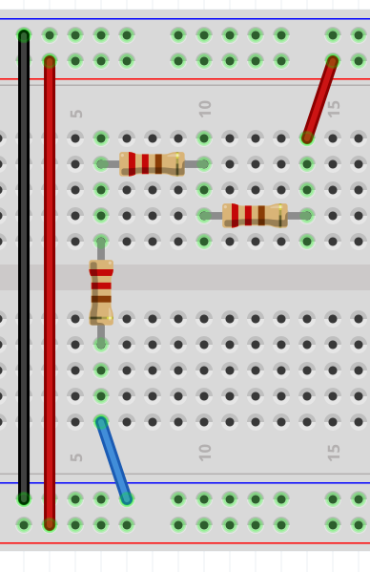
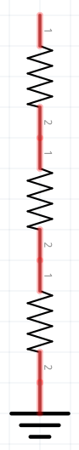
Example Circuit
To Arduino GND and +5V
GND
+5V
+5V
R_{A}
R_{B}
R_{A}
R_{B}
R_{C}
R_{C}
Symbol for GND
GND
+5V

Slide 17
Showing Internal Connections
To Arduino GND and +5V
GND
+5V
+5V
R_{A}
R_{B}
R_{A}
R_{B}
R_{C}
R_{C}
Symbol for GND
GND
+5V

Slide 18
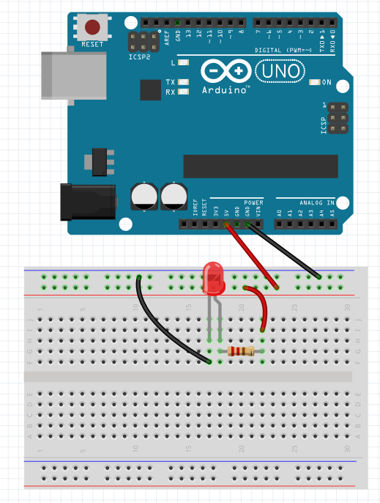
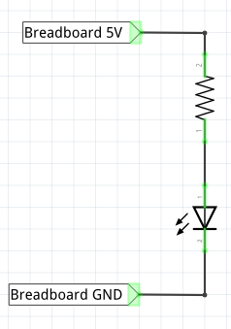
Build your first breadboard circuit
Hands On
First: try 220Ω
Then: try 10kΩ
(long)
LED
(short)
Guidelines:
Any wire colors work
Usually Red = 5V
Usually Black = GND
Schematic Diagram
short(-)
Notes:
More resistance = less current = less light
Less resistance = more current = more light

Slide 19
Build your first breadboard circuit
Hands On
First: try 220Ω
Then: try 10kΩ
First: try 220Ω
Then: try 10kΩ
(long)
LED
LED
(short)
Guidelines:
Any wire colors work
Usually Red = 5V
Usually Black = GND
Schematic Diagram
short(-)
Notes:
More resistance = less current = less light
Less resistance = more current = more light

Slide 20


Connect Arduino to computer using USB Cable
Hands On
Avoid USB Sockets on the monitor…
The’re not always connected
USB Cable
Notes:
More resistance = less current = less light
Less resistance = more current = more light

Slide 21
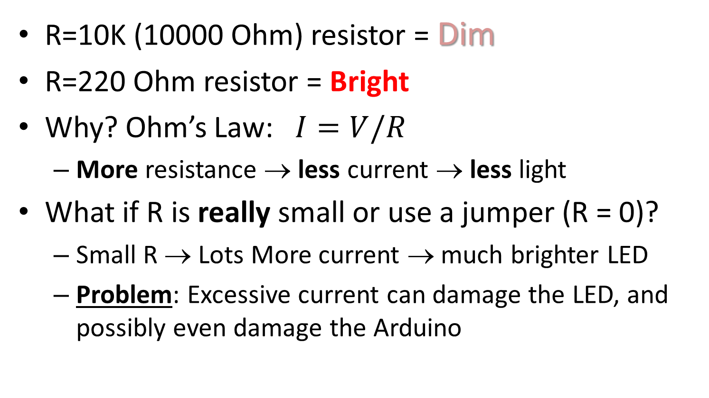
What Happened?
Hands On
R=10K (10000 Ohm) resistor = Dim
R=220 Ohm resistor = Bright
Why? Ohm’s Law: $I=V/R$
More resistance → less current → less light
What if R is really small or use a jumper (R = 0)?
Small R → Lots More current → much brighter LED
Problem: Excessive current can damage the LED, and possibly even damage the Arduino

Slide 22
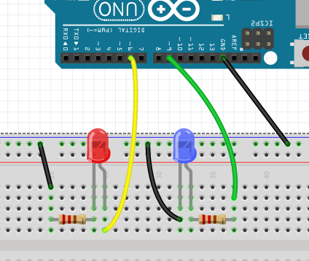
Takeaway Lesson
Hands On
The resistor can go on either the short leg or long leg side of the LED
Always use a resistor to protect the Arduino and LEDs
Called “current limiting resistor”
Resistance value is not critical, as long as it’s greater than 100 ohms
We usually use 220 ohms because many are included in our kit
Choose larger values for dimmer LED, e.g., 1K to 10K
Short Leg
Either works fine

Slide 23
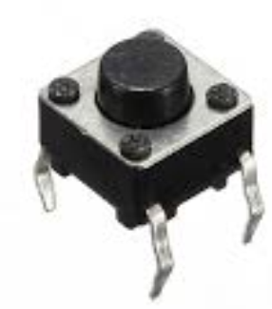
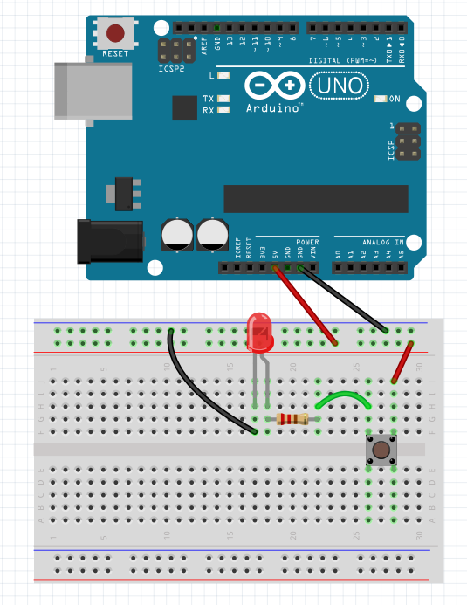
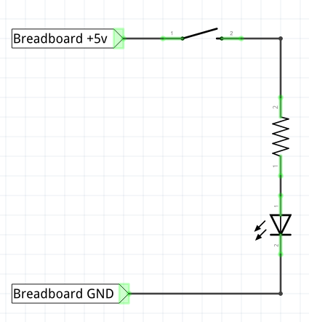
Add pushbutton switch (and please put the resistor back in)
Hands On
You may have to bend the legs a little
Pushbutton Switch
220Ω
“Series” circuit
gap
Pushbutton MUST be placed over gap

Slide 24
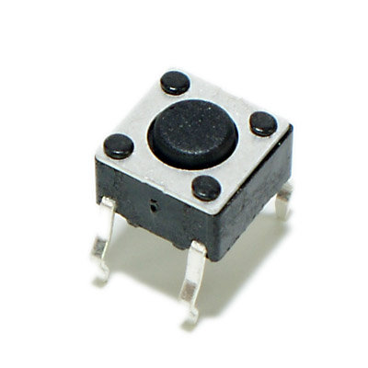
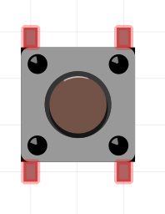
Pushbutton Switch
Hands On
Pushing the button temporarily connects the left two pins to the right two pins. Current can flow.
When button not pushed, it blocks current flow

Slide 25
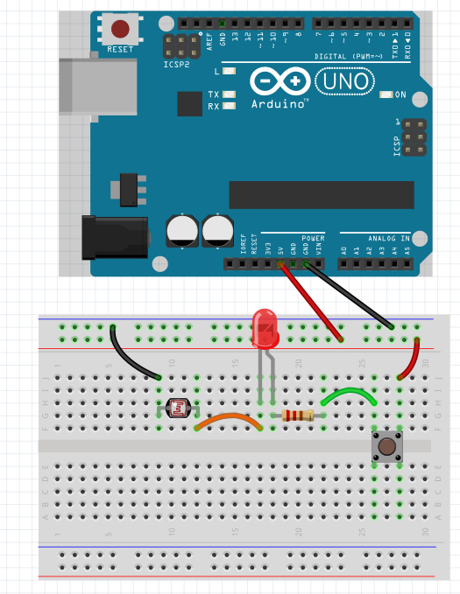
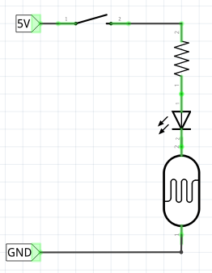
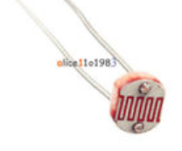
Hands On
Next, add a Photoresistor
Also called a “Light Dependent Resistor” (LDR) or “Light Sensitive Resistor” (LSR)
220
LDR
Schematic Diagram
Photoresistor

Slide 26
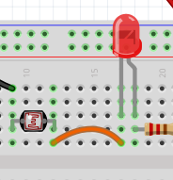

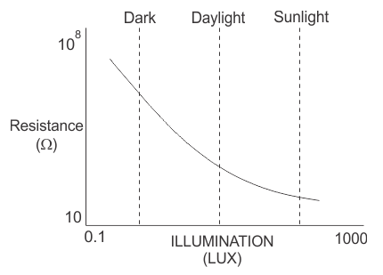
Hands On
Move your finger over the photo resistor (while pushing the button)
Photo-Resistance increases as light decreases
More light (less resistance)
→ More current
→ Brighter LED

Slide 27
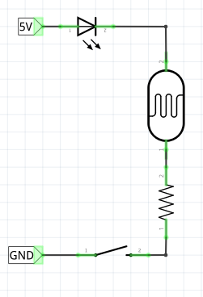
Hands On
This is called a “Series Circuit”
Order of components doesn’t matter!
Same current through all components
SAME!
LDR
LDR

Slide 28

We had a computer??
That could read the pushbutton switch
That could read the light sensor or other sensors
That could automatically turn on LEDs using built-in timer
That could control motors, sounds, and displays

Slide 29
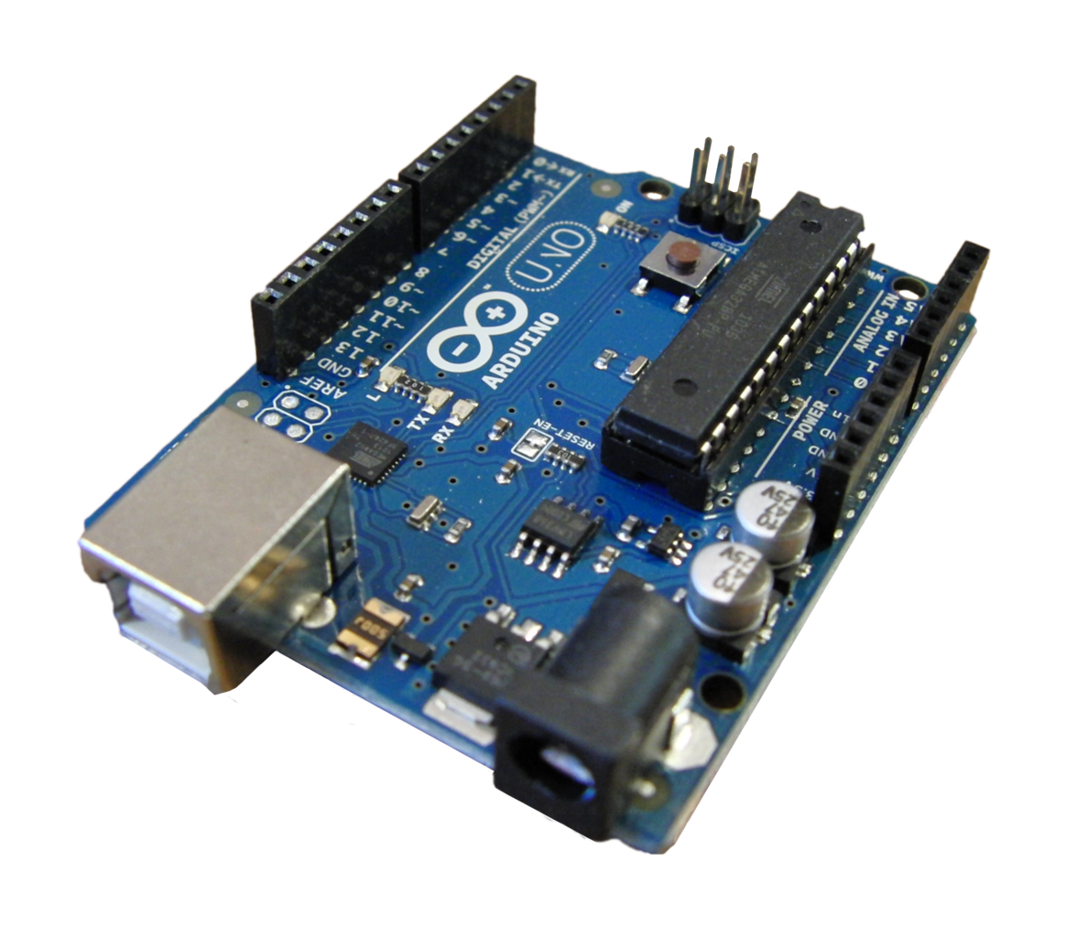
Part 2: Arduino Basics
ELECTRICAL ENGINEERING AND COMPUTER SCIENCE, COLLEGE OF ENGINEERING AND PHYSCIAL SCIENCES

Slide 30
Arduino is a “Microcontroller”
Microcontroller = small computer Sometimes called a microcomputer or microprocessor
What can we do with a microcomputer?
Connect input devices to sense the world
Sensors: temperature, pressure, light, gyroscope, microphone, GPS
Connect output devices to control the world
Motors, actuators
Speakers to make sounds and music
LEDs and LCDs to display information
Connect to the world
Easy to add wi-fi, blue tooth, ethernet, and long-range radio capabilities
Secret Sauce: computer programs that we write!

Slide 31
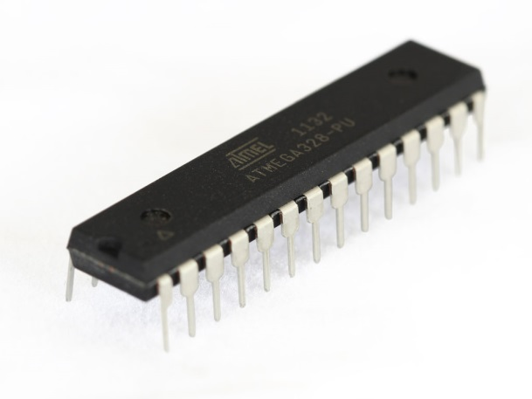
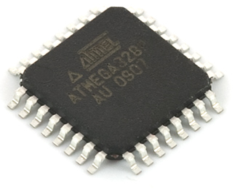
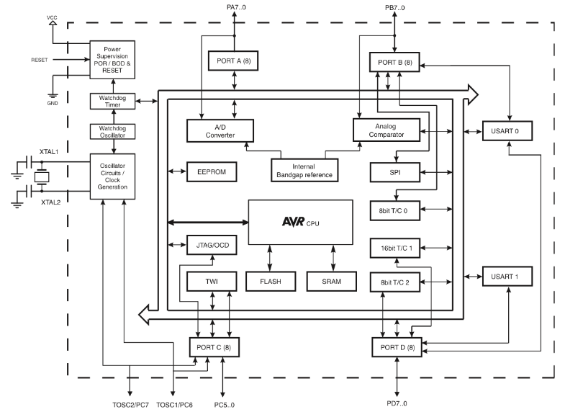
Atmega328 micro-controller The Brain
“Pins”
Analog to Digital Converter
Clocks and Timers
“Pins”
Communications
Microprocessor
Memory
Notes:
Point out what pins are so the next slide makes sense!

Slide 32
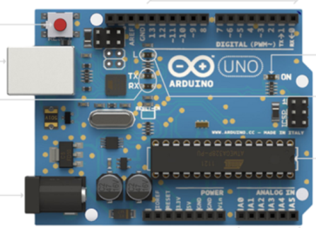
What are “Pins”??
Arduino sockets called “Pins”
“Pins” 0-13
Microcontroller pins are wired to sockets
We plug jumper wires into sockets to make our circuits
These sockets are called “pins”
Microcontroller Pins

Slide 33
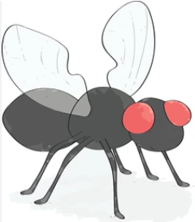
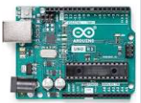
What’s on board
GPIO pins 0-13
Atmega328 micro-controller.
16 MHz (not GHz!)
32 kB program memory
2 kB RAM (NOT GB!)
Comparable to computer running the Hubble Space Telescope
General Purpose Input/Output (GPIO) pins 0 - 13
GPIO+ (adds “analog”) A0-A5
Power and Ground
Reset: restarts the program
5
2
1
4
3
A fruit fly has about 100,000 neurons.
An Arduino has about 100,000 logic gates…
Notes:
Original Hubble computer (DF-224) 1.25 MHz, built by Rockwell
First service mission (1993), added 16 MHz 387 coprocessor
3d service mission (1999), 25 MHz 486
A fruit fly comes preprogrammed to fly.
Arduino’s program memory starts out empty – what can we program it to do?

Slide 34
Arduino UNO versions
We use the UNO Revision 3 (R3), released in 2011
A new R4 version was released in 2023
R3 and R4 are mostly compatible, but
R4 is faster, has more memory, includes LED matrix and WiFi
Pricing: R4 is about $27, R3 clones are $5-10

Slide 35

Why We Use R3 rather than R4
Learning to program is the same on both systems
Except for advanced applications such as WiFi
R3 is robust (doesn’t damage easily). And it’s cheaper!
Many inexpensive R3 clones and educational kits are available
Currently, no cheap R4 clones are available.
For special projects you might need something more
Consider the full range of Arduino development boards, capabilities, and prices. Maybe even consider a Raspberry Pi!

Slide 36
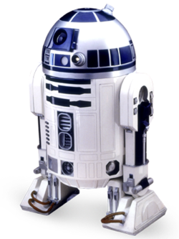
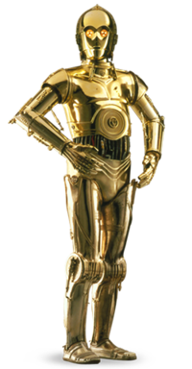
Arduino
Raspberry Pi
No Operating System, runs only one program at a time, not very fast, limited memory
Six analog inputs
Great at simple repetitive tasks, many sensors, many outputs, good in “embedded systems”
Requires little electrical power
Battery lasts a long time
Like R2-D2
Linux, general purpose computer, multiple programs run simultaneously, fast, lots of memory
No analog inputs
Great for running sophisticated software, browsers, games, word processing. But it’s overkill for simple applications
Requires 10x more power
Power source is usually not a battery
Like C-3PO
Scrappy
Speaks only Binary
Suave
British Accent
Speaks 6 million languages
Both systems have a HUGE “eco system” for support

